Slide 1
Multiple Regression
Edward Wang, Ph.D.

Slide 2
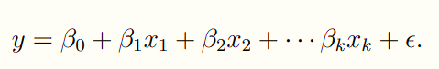
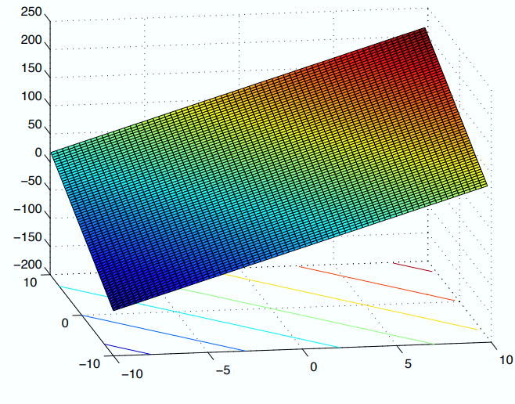
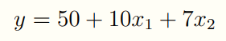
Fundamental Idea
A multiple linear regression model with k variables x₁, x₂, …, x_{k} and a response y, can be written as:
Example

Slide 3
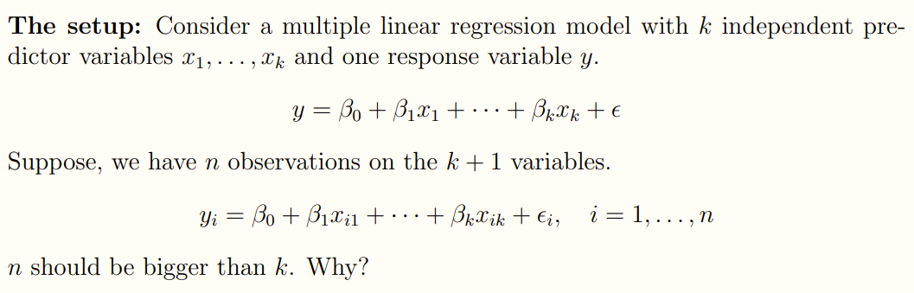
Estimation of Model Parameters-Least Square
http://mezeylab.cb.bscb.cornell.edu/labmembers/documents/supplement%205%20-%20multiple%20regression.pdf

Slide 4
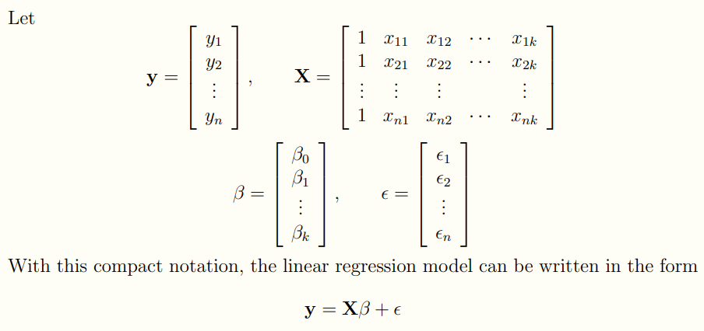
Estimation of Model Parameters-Least Square
http://mezeylab.cb.bscb.cornell.edu/labmembers/documents/supplement%205%20-%20multiple%20regression.pdf

Slide 5
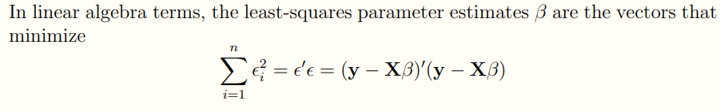
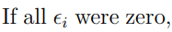
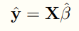
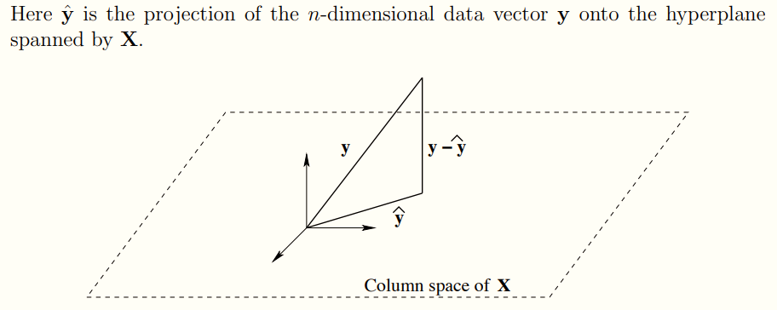
Estimation of Model Parameters-Least Square

Slide 6
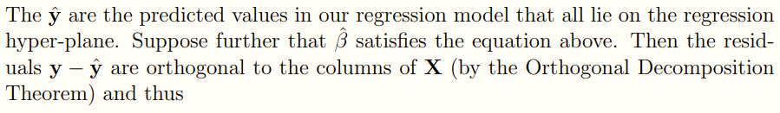
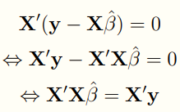
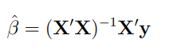
Estimation of Model Parameters-Least Square
http://mezeylab.cb.bscb.cornell.edu/labmembers/documents/supplement%205%20-%20multiple%20regression.pdf

Slide 7
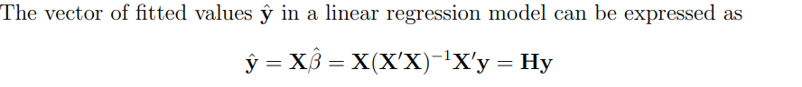
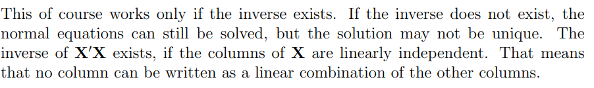
Estimation of Model Parameters-Least Square
http://mezeylab.cb.bscb.cornell.edu/labmembers/documents/supplement%205%20-%20multiple%20regression.pdf

Slide 8
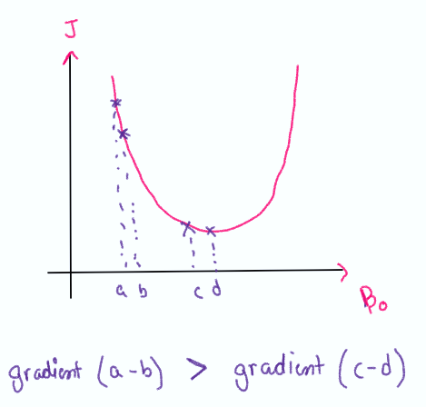
Estimation of Model Parameters-Gradient Descent
Gradient Descent is an optimization algorithm. Gradient means the rate of change or the slope of curve.

Slide 9
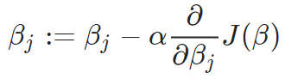
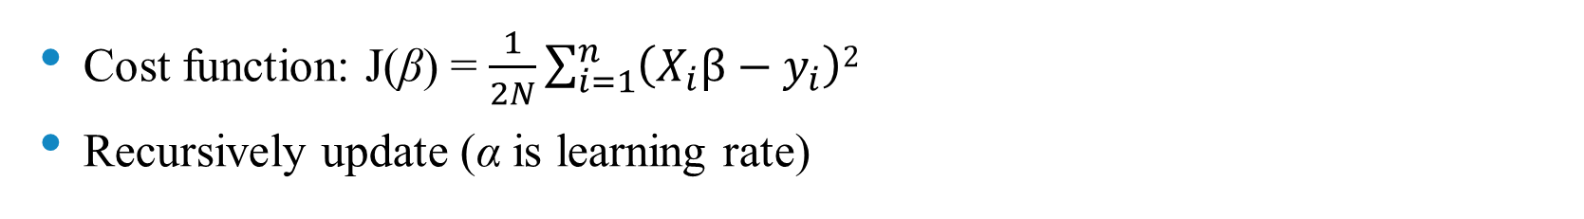
Estimation of Model Parameters-Gradient Descent
Cost function: J(β) = $\frac{1}{2N}\sum_{i=1}^{n}{\left(X_{i}β−y_{i}\right)2}$
Recursively update (α is learning rate)

Slide 10
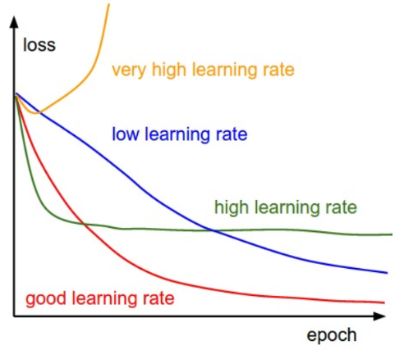
Estimation of Model Parameters-Gradient Descent
Pick a value for the learning rate α. The learning rate determines how big the step would be on each iteration.
If α is very small, it would take long time to converge and become computationally expensive.
If α is large, it may fail to converge and overshoot the minimum.
http://cs231n.github.io/neural-networks-3/

Slide 11

Estimation of Model Parameters-Gradient Descent
The algorithm will converge when slope becomes 0

Slide 12
Case Study-Part Quality Prediction
SE75DUZ Injection Molding Machine
Sumitomo SE75DUZ injection molding machine
75 ton fully electric
Priamus eDAQ 8102A (500 Hz)
Two Priamus 6001A pressure sensor (Runner & Gate)
Priamus 4001A type N thermocouple (Cavity end)
NI-USB6212 DAQ (10 kHz)
OS 1562 optic IR (Cavity end)
Gao et al., “ Online product quality monitoring through in-process measurement”, CIRP Annals-Manufacturing Technology, 2014.

Slide 13
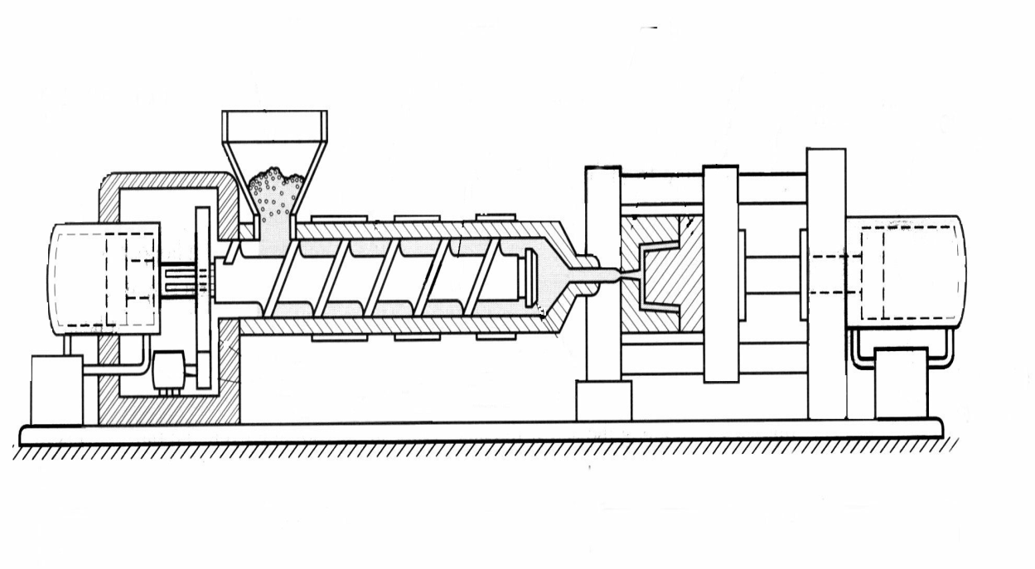
Design of Experiment
Mold
Barrel
Motor
Run # | Barrel Temp (℃) | Mold Temp (℃) | Pack Pres (Mpa) | Injection Velocity (mm/s)
1 | 190 | 21 | 30 | 10
2 | 190 | 21 | 30 | 40
3 | 190 | 21 | 30 | 100
4 | 190 | 60 | 50 | 10
5 | 190 | 60 | 50 | 40
6 | 190 | 60 | 50 | 100
7 | 220 | 60 | 30 | 10
8 | 220 | 60 | 30 | 40
9 | 220 | 60 | 30 | 100
10 | 220 | 21 | 50 | 10
11 | 220 | 21 | 50 | 40
12 | 220 | 21 | 50 | 100
Nozzle
Factor | Two levels
Barrel Temp | 190 ℃ | 220 ℃
Mold Temp | 21 ℃ | 60 ℃
Pack Pres. | 30 MPa | 50 MPa
Factor | Level
Injection Velocity | 10
 | 40
 | 100
Half factional factorial DOE, 2³⁻¹x3 = 12 runs
20 cycles per run

Slide 14
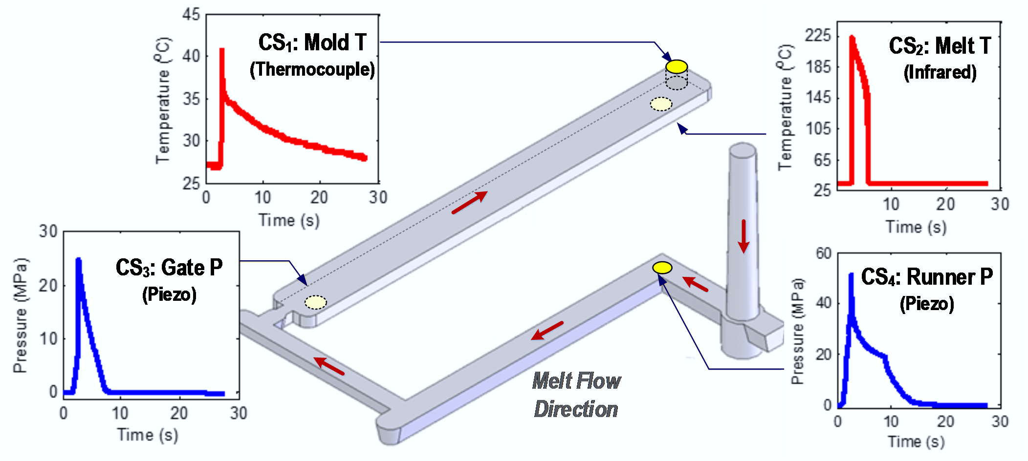
Molding Process Monitoring
Commercial Sensors (CS)
1 parameter/package
Either pressure or temperature
Wire connection required for data transmission
Through hole
CS₁: Peak temperature & cooling rate in Mold T;
CS₂: Peak temperature in Melt T;
CS₃: Peak pressure in Gate P;
CS₄: Peak pressure in Runner P;

Slide 15
Data Analytics-Regression
Predict part thickness upon 4 measurements

